Slide 1
Technical Support (420-1N6-AB) Computer Hardware: BIOS, CMOS & UEFI
Fall 2022

Slide 2
Outline
BIOS
CMOS
UEFI

Slide 3
What do we have so far..
Computers consist of different hardware components:
Keyboards and mice for input.
Monitors, sound cards and printers for output.
Permanent storage devices to store programs and data.
These hardware components can store/manipulate information represented by “on” and “off” states (binary, logic circuits)
The CPU communicates with all devices connected to the computer.
Chipsets allow all communication to happen.
Using Northbridge and Southbridge and the bus.

Slide 4
CPU Meets Hardware Components
The CPU needs some program(s) loaded into memory that teaches (informs) it about a particular device so that it knows how to communicate with it. This program is known as
Basic Input/output Services (BIOS).
These programs that are dedicated to enabling the CPU to communicate with different hardware components.
Known as services or device drivers.

Slide 5
CPU Meets Hardware Components (cont.)
The code to communicate with the most important hardware (keyboard, monitor, mass storage drives, optical drives, USB ports and RAM) is stored on the motherboard on a special device called a read-only memory (ROM) chip.
Remember: ROM chips are non-volatile (the information is not erased when the computer is switched off).
Modern motherboards use flash ROM whose contents can be changed through a process called “flashing the ROM”.

Slide 6
CPU Meets Hardware Components (cont.)
Every motherboard has a flash ROM chip called the “system ROM chip” containing code that enables the CPU to talk to the basic hardware of your PC.
These services are collectively called the “System BIOS”.
The system BIOS supports all the hardware that never changes (e.g. keyboard controller, PC speaker that beeps at you) by storing the BIOS for these devices.
Note: programs stored on ROM chips are referred to as firmware.
Firmware: the software that directly controls computer hardware, below the level of the Operating System

Slide 7
So What is System BIOS?
In summary, BIOS:
Basic Input/Output System
Known as system BIOS, ROM BIOS, or PC BIOS.
Firmware embedded on a non-volatile chip on the computer's motherboard.
Pre-installed on the motherboard by the manufacturer.

Slide 8
How does BIOS work?
Computer starts up
BIOS loads into memory
BIOS wakes up the computer’s hardware components
BIOS performs a Power-On-Self-Test (POST) to make sure that all connected hardware components are working properly.
BIOS looks for a boot loader on the storage device to initialize the installed operating system.

Slide 9
Power-On-Self-Test (POST)
If the computer passes the POST, the internal speaker will make a short single beep indicating that the computer has passed the test and is booting up normally
If there are no beeps or multiple beeps, this indicated that the computer has failed POST.
There is an error and further troubleshooting is required to find out what is the problem.
The computer will generate a beep code to help you pinpoint the problem.
Examples:
Three long beeps could indicate a keyboard error.
A continuous short beep could indicate a problem with a RAM module.
Always refer to the motherboard manufacturers’ documentation to examine a list of beep codes and what they indicate to be able to pinpoint the problem and correct it
Every computer and manufacturer will have a different standard for what each beep code means.

Slide 10
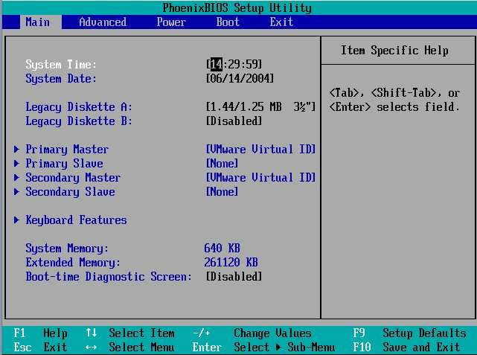
BIOS Settings
After the computer is turned off, it needs to maintain certain settings such as:
Date and time
Boot sequence
Certain hardware settings
Many important custom settings can only be configured in the BIOS.
These settings are stored on another chip on the motherboard (CMOS)

Slide 11
CMOS
A separate memory chip called CMOS (complementary metal-oxide semiconductor) that stores the information that describes specific device parameters.
CMOS also acts as a clock to store the current date and time.
CMOS is the semiconductor technology used in the transistors.
Made of silicon and germanium which conduct electricity but only under certain controllable conditions (semiconductor).
Use almost no power when not needed but can become very hot when in use. (This limits their speed significantly.)
CMOS is usually powered by a coin-sized CR2032 cell battery, referred to as the CMOS battery.
Most CMOS batteries will last the lifetime of a motherboard, up to 10 years in most cases, but will sometimes need to be replaced.
Incorrect or slow system date and time or loss of BIOS settings are signs of a dead or dying CMOS battery.

Slide 12
CMOS (cont.)
Initially the CMOS was a separate chip on the motherboard.
Nowadays it is almost always built into the Southbridge.
The information stored in CMOS is vital for the computer to function.
Every computer ships with a program that allows you to access and modify CMOS data.
CMOS can be accessed at computer boot by pressing a special key (depends on the manufacturer)
Usually it would be F1, F2, F10, F12, Del or a key combination -- again, it will be different for every manufacturer

Slide 13
Common CMOS Options
System date/time | Set the system date and time.
Boot sequence | The order that BIOS will try to load the operating system.
Plug and play | A standard for auto-detecting connected devices.
Mouse / keyboard | Settings to enable number lock, auto-detect the mouse, etc.
Drive configuration | Configure hard drives, CD-ROM and floppy drives.
Security | Set a password for accessing the computer
Power management | Select whether to use power management, as well as the amount of time for standby and suspend.

Slide 14
BIOS Limitations
BIOS was the only firmware service of its kind for a long time. (Early MS Dos computers in 1980 had BIOS.)
BIOS had several limitations:
Each motherboard manufacturer had to produce their own BIOS. (customised to at particular set of hardware components).
Must run in 16-bit processor mode and only has 1 MB of space to execute in.
Has trouble initializing multiple hardware devices at once, which leads to a slower boot process when initializing all the hardware interfaces and devices on a modern computers.
Can only boot from drives of 2.1 TB or less.
Can only support keyboard access.

Slide 15
BIOS Replacement
Intel developed the Extensible Framework Interface (EFI) - an open system of standards for developing firmware for hardware components.
Without the entire framework needing to be architecture specific.
This grew into UEFI (Unified Extensible Framework Interface), which is maintained by a group of technology companies including Apple, Microsoft, IBM and Intel.

Slide 16
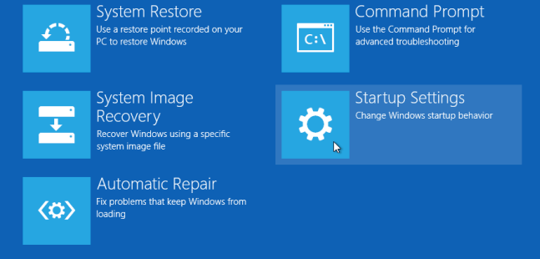
UEFI
UEFI is a customizable framework which does not require a separate program (boot loader) to launch the operating system.
UEFI Includes native support for HDDs larger than 2 terabytes.
UEFI has user-friendly graphical user interface that supports different colors and even animations with mouse support.
UEFI also has a built-in feature called secure boot.
Secure boot stops any digitally unsigned drivers from loading.
Helps to stop malicious software such as rootkits.
OS Support:
Windows 8 and newer PCs use UEFI instead of BIOS.
Apple MAC has used UEFI for years.
Linux doesn’t have a dedicated hardware manufacturer, so Linux users have used whatever they want for years! Mostly UEFI but there are some alternatives

Slide 17
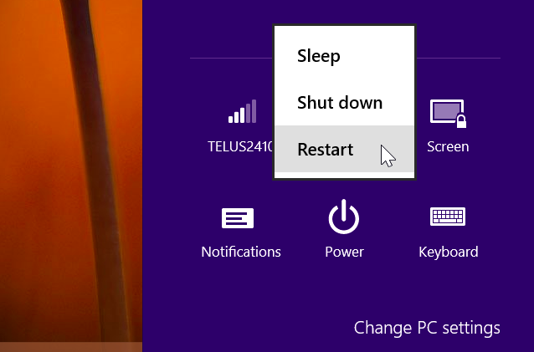
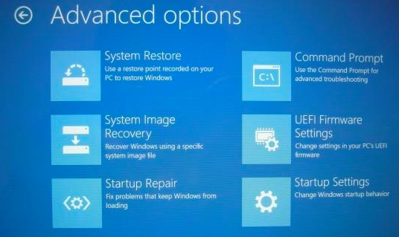
How To Access UEFI Settings
Windows 10 & 8:
Hold down Shift when restarting.
Settings → Update and Security → Recovery → Advanced Startup.
In command prompt, type
shutdown.exe /r /o
Click “UEFI Firmware Settings” to access firmware options (like BIOS).

Slide 18
Q & A
Notes:
In Slide Show mode, click the arrow to enter the PowerPoint Getting Started Center.

